Slide 1
Volcanoes
Earth and Space Science

Slide 2
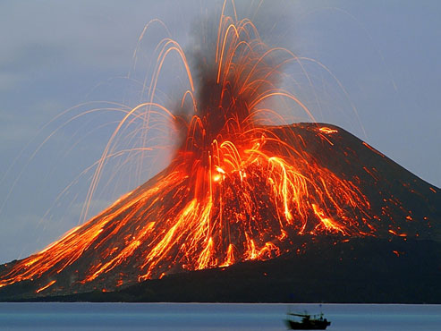
How many are there?
About 60 of the ~550 known active volcanoes erupt each year
There are many more volcanoes underwater than on land

Slide 3
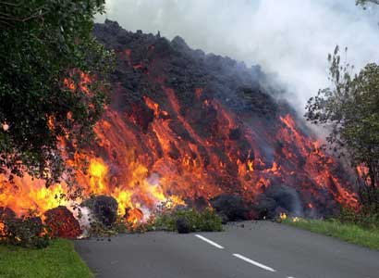
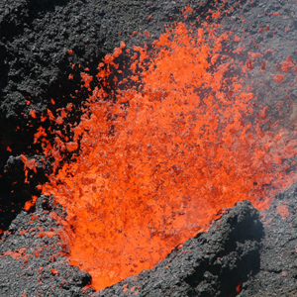
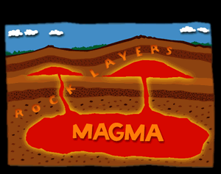
Magma vs. Lava
Magma – hot molten rock under the crust
Lava – hot molten rock on top of the crust

Slide 4
Where can Volcanoes be Found?
Click here to see where you can find a volcano near you.
Click here to see 10 of the most active volcanos

Slide 5
Underwater Volcanoes
Mid-oceanic ridge – continuous mountain range where divergent plates are spreading apart, and magma is pushing up in between the two plates
Mid-Atlantic ridge, Indian Ocean,
South Pacific Ocean

Slide 6
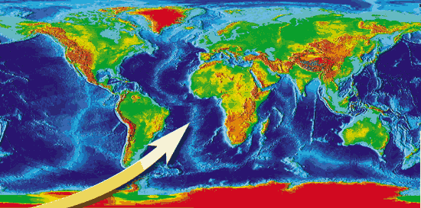
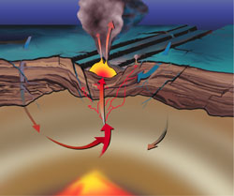
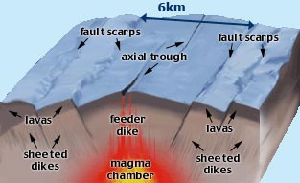

Slide 7
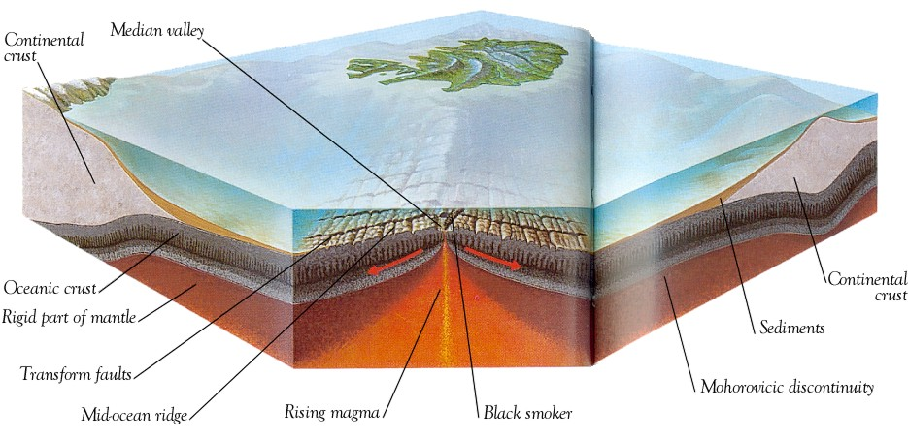
Underwater Volcanoes
Rift valley – deep central cleft in the crest of the mid-ocean ridge, can begin on land where two plates move apart

Slide 8
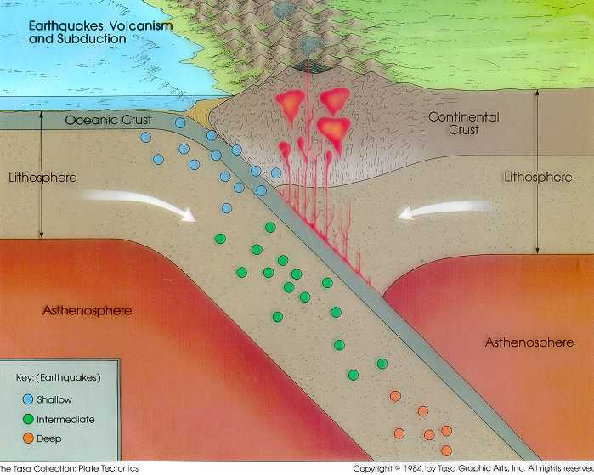
Volcanoes on Land
Generally found at convergent plate boundaries

Slide 9
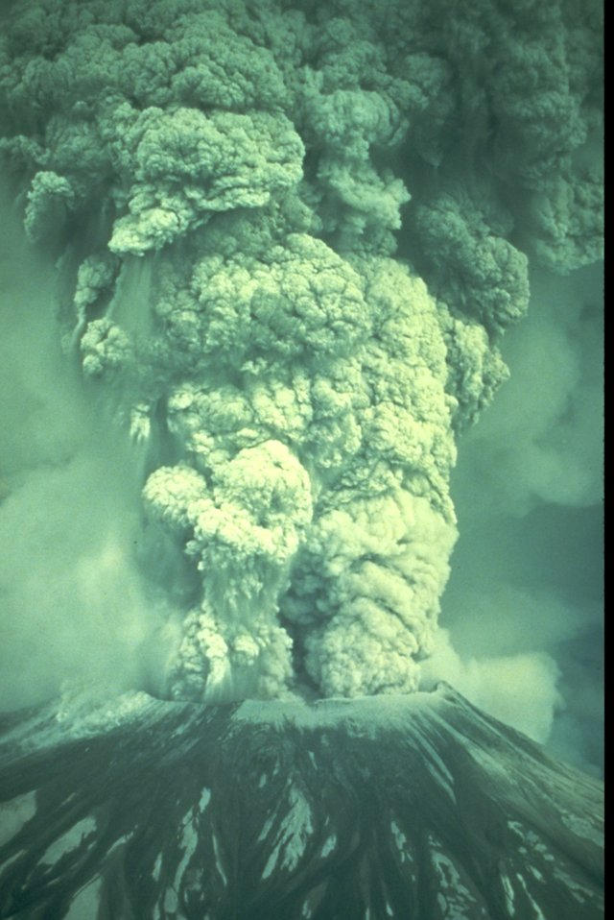
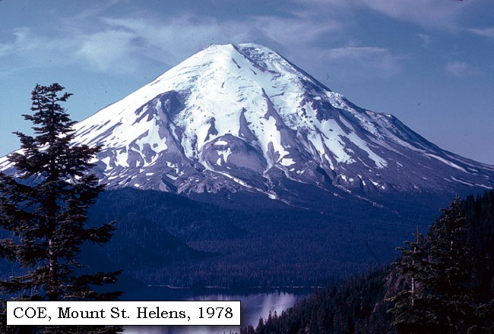
Example: Western U.S. → Mt. St. Helens

Slide 10
Volcanoes on Land
Ring of Fire – an area around the Pacific Ocean containing the majority of the active volcanoes on the Earth
Convergent plates are being subducted,
forming magma, which rises up in the crust,
and erupts as volcanoes

Slide 11
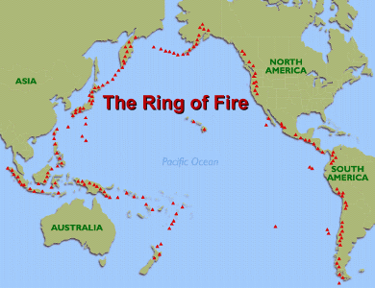
The Ring of Fire

Slide 12
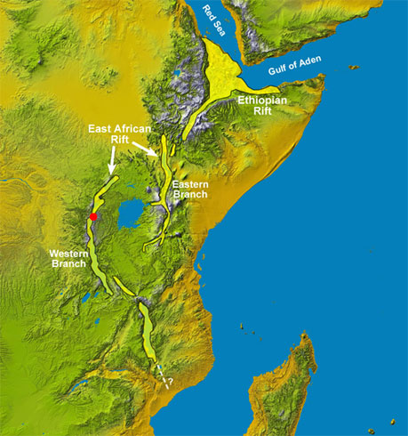
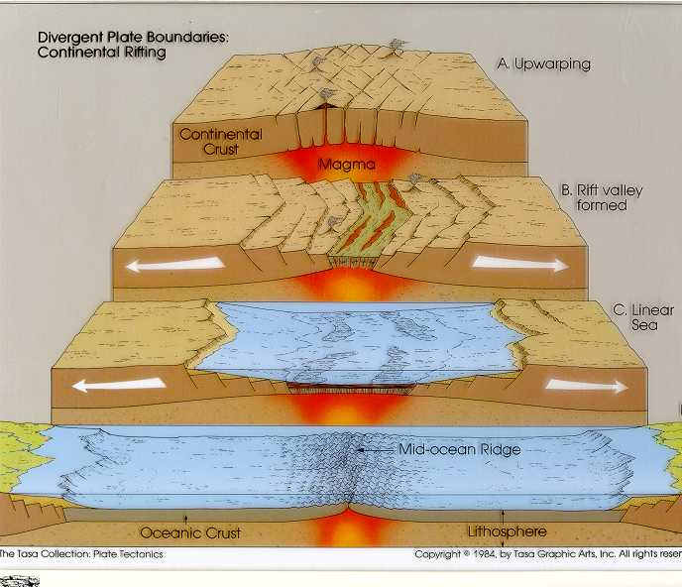
Volcanoes on Land
East African Rift Valley volcanoes are similar to underwater volcanoes at divergent plate boundaries

Slide 13
Volcanoes at Hot Spots
- Small percentage of volcanoes
- Hot spot – a fixed source of magma close to the Earth’s surface which has persisted for
long periods of time; also called mantle plumes

Slide 14
Volcanoes at Hot Spots
- As tectonic plates move over the mantle plume, magma pushes up through the crust
forming a volcano.

Slide 15
Volcanoes at Hot Spots
- Eventually the plate moves far enough that a new volcano forms over the plume
- This can form a chain of volcanic islands and/or seamounts
→ Hawaiian Islands

Slide 16
Volcanoes at Hot Spots
- Seamount – a volcanic island that is not above the water’s surface

